Slide 1


SAP CLOUD APPLICATION PROGRAMMING AND XSA TRAINING IN BTP
Anubhav Oberoy
Day – 3

Slide 2

Agenda – Day 3
Creating our first service
Introduction to the Git and GitHub
Creating our first git repository
Adding our project to the Git Repository
Understanding EMP data model for our use case
Creating the DB Tables
Building and Deploying the Project to HANA Cloud
Introduction to the Aspects
Abstract Entities
Concept of Localization
Localization of Dynamic Content
Localization of Static Content
Loading data in Database
Introduction to OData
Understanding the OData service
Operations related to the OData Service
OData query options
Exposing the OData in the CAPM

Slide 3
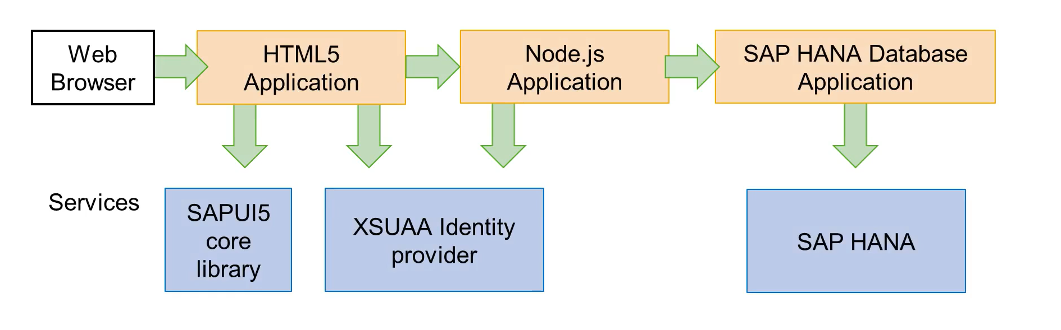
What is Multi-Target Application (MTA)
A Multi-target Application (MTA) is comprised of multiple parts (modules), created with different technologies and deployed to different targets, but with a single, common lifecycle.
It is a good practice to use separate applications for the 3 tiers: front-end, application and database. So a full-stack application is typically made of the combination of multiple applications and service instances.
That’s why SAP extended the Cloud Foundry standards, introducing the concept of Multi-Target Application

Slide 4

Introduction to Git and GitHub
Git is a version control system that lets you manage and keep track of your source code history.
GitHub is a cloud-based hosting service that lets you manage Git repositories.
Git HUB is a central repository to store all the code. Git is a distributed repository management system, which allows development teams to organize and sync their development code.
Use Case- I am working as a Fiori Developer in an MNC and I want to share my code with fellow developers, currently I am downloading the zip/tar file and sharing over email.
This way we will have piles of emails in our account,
especially when we work in a team of size 40 developers it becomes very hard to sync changes.
There is version control. Last night my app was stable, I made some changes this morning which messed up the whole project. I some how pray to god that can you please take me in past.
In a big team, many developers touching each other’s code and it’s hard to blame someone who disrupt the code.
It is also very hard to merge changes when done in same file.
As a developer, I am using BAS today, tomorrow I will use VS Code and next day Web IDE and very next week Atom. How can I easily port my code between these tools.
You can install git in local machine using below link (however, it comes along with all dev tools)
https://git-scm.com/downloads

Slide 5

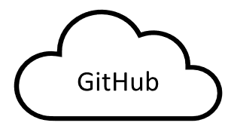
How GitHub Works and commands in Git
We will see some important commands related to Git and will see how GitHub works.
Some important commands to use git.
git Init: It is used to initialize a new Git Repository in the system.
git add <filename>: It is used to stage the changes of the file to git repository. We can use ‘git add .’ to stage the changes of all files.
git commit: It is used to commit all the staged changes with a message.
git reset hard: Discard all the staged changes and discard the changes in all the files.
git push: It is used to push all the changes in the git repository.
git pull: It is used to pull the new changes made by other users in the project.
git status: It is used to check the status
git clone: It is used to clone a repository.
git remote add <repo URL>: Add a local repository to a remote repository.
Project (or any kind of project)
User (Anubhav)
But how all users will work on the project at a same time?
Anubhav’s local machine
Here GitHub comes into picture
Users which are working on the different parts of the same project on different Platforms (BAS, VS Code, Web IDE)
Project Repository
The project will be kept in a repository in the GitHub

Slide 6
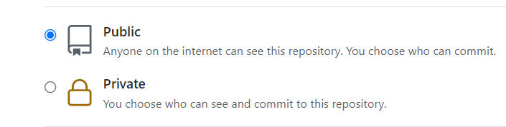
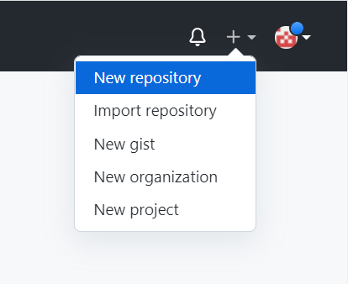
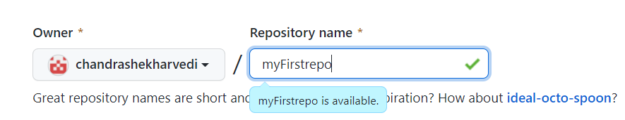
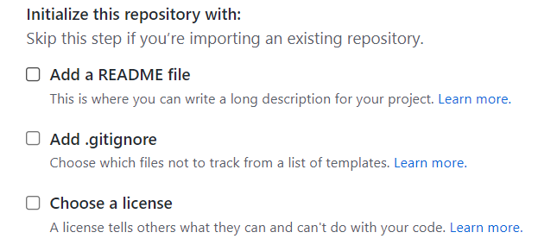
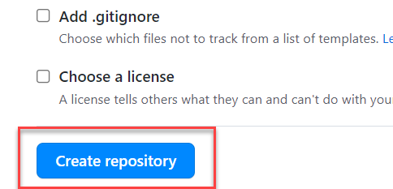
Steps to Create a new git Repository
Step by Step process to create a git repository in GitHub. First of all you must have a GitHub account, if not then go to this link https://github.com/signup?source=login and create a new Account.
Step 1: Click on the plus button in the top right corner of the screen and select ‘New Repository’.
Step 2: Type a short, memorable name for your repository. And give a description (optional).
Step 3: Select the type of repository. Public or Private
Step 4: Set how you want to Initialize the repository.
Step 5: Click on Create Repository. Your Repository will be created.
Repository Created Successfully

Slide 7
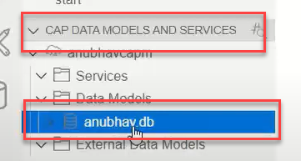
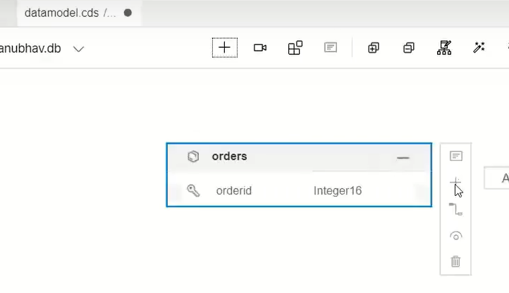
Creating our first sample table
As last we have seen how to create a simple service using the CAPM framework, now we will see how to create a simple database table using the CAPM.
The CAPM framework work in a database agnostic way, it means it is not tightly coupled to a specific data base. It generates the database code according to the database we are using/specified.
So, the capm framework say that you have to write your data model in a .cds file then I will auto generate the DB operation code automatically accordingly.
HANA
.cds file
{
----------- or
-----------
}
Graphical Modeler
CAPM Framework
MySQL
The Business Application Studio Provides us a graphical editor using that we can easy generate our data model without worrying about the underlying code.

Slide 8
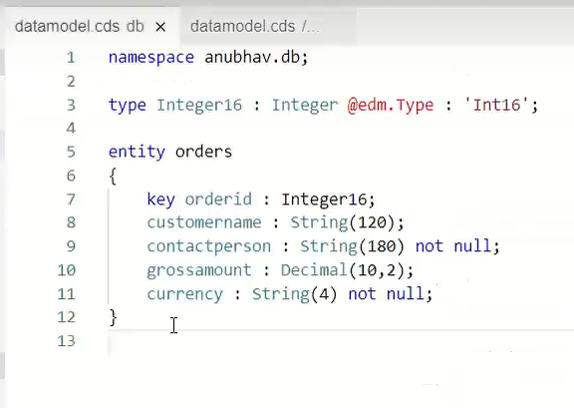
Hands-on: Sample DB Table with sample data
Create a sample table in the application. For that first create a new file named datamodel.cds under the db folder and create the first db table definition.
Exercise code/resource:
datamodel.cds
csv file

Slide 9
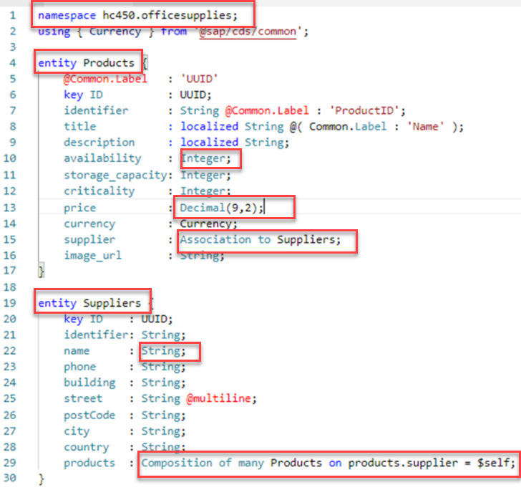
CDS – Core Data Services
Core Data Services - Data definition Language
Namespace: are used to help getting to unique names , this helps to keep the code clean by avoiding fully qualified names.
Entities: represent data that can be read and written by consumers, uniquely identified by their primary keys.
For Example, Products and Suppliers are defined as Entities
Types: describe the types of elements within entities.
Various built-in types are provided. For example Integer, Decimal and UUID as seen in the screen shot – UUID are autogenerated ID’s
Associations: capture relationships between entities.
For example, Entity Products is Associated with Entity Supplier
Compositions: are used to model document structures through "contained-in" relationships.
For example, in the definition of Suppliers, the Products composition refers to the Products entity.

Slide 10
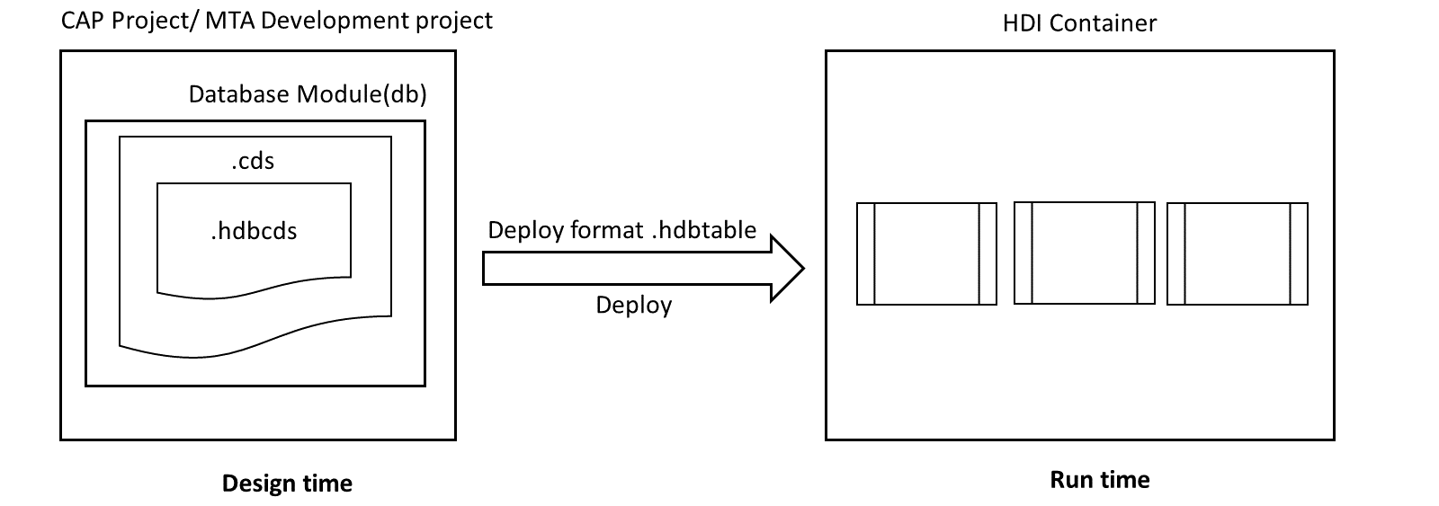
Table Creation Process
Core Data Services (CDS) is a technique used to create the persistency layer (the database layer) of a software application.
During software development the data model is defined via a Data Definition Language within a file with extension .cds.
When the application is built and then deployed, a set of database tables is generated in the database reproducing the data structure described in the file.
Note: If the .cds file is modified and the program is re-built, the created database objects are automatically changed to realize the new model.

Slide 11
EPM Data Model for our use case
Now we want a use case to create the Database tables.
In this use case we will include simple tables and association between the tables.
Addresses
Business Partners
(Customer, Vendors)
Purchase Orders
1 n
1
n
Products
Purchase Order
Items
Product Texts

Slide 12

Exercise
In this exercise we will create our first database table.
For this exercise we have to
Create a datamodel.cds file inside the db folder
Write the data definition of the table in the file. (copy from the git link provided below)
Exercise Code/Resources:
datamodel.cds

Slide 13
Build and Deploy to HANA Cloud
Build
Now once we have defined our database table using the Data Definition, now we have to deploy this to HANA Cloud to create the tables in the HANA Cloud Database.
But hana only understands the hdbtable format, so first we have to build the project so that all the .cds artifacts will be converted into hana specific artifacts i.e., .hdbtable. To do this we have to run a command ‘cds build’.
This command will generate a new gen folder in our project directory, this newly generated folder contains all the hana specific artifacts.
Deploy
Once our project is successfully build, we are ready to deploy our project to the HANA Cloud for the first time.
Steps to deploy the project to HANA Cloud.
Expend the SAP HANA Projects View
Bind the project with a hana instance.
In the popup you can choose an existing one or can create a new instance
Once the instance is bind to HANA cloud press the rocket button to deploy.
We can also use the command ‘cds deploy --to hana:containerName’
Using this command if the container is not present in the HANA database it will create a new container automatically.

Slide 14
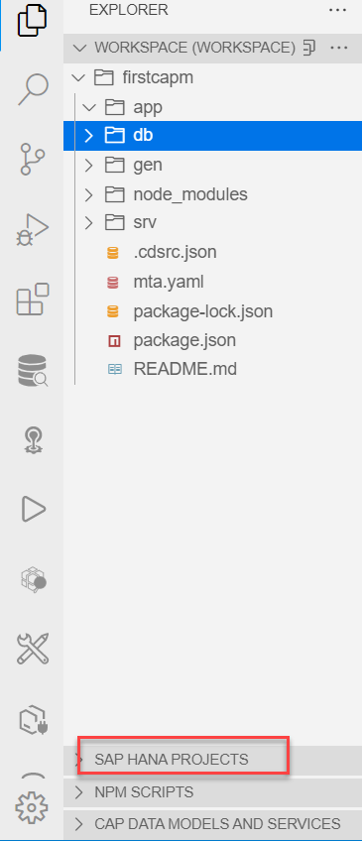
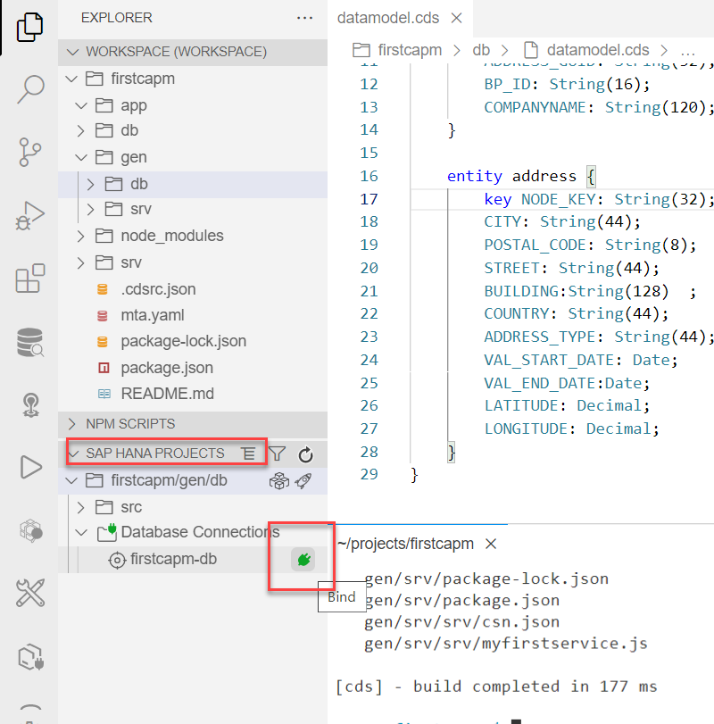
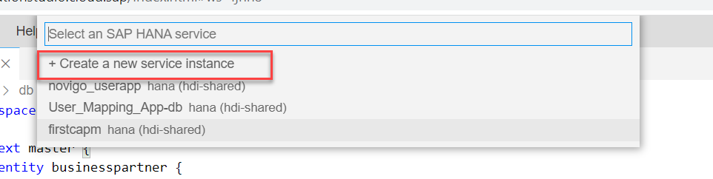
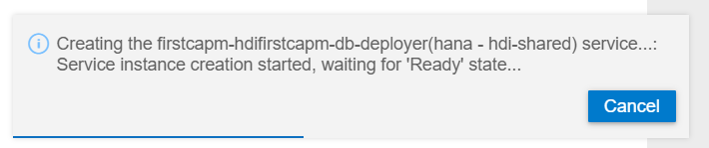
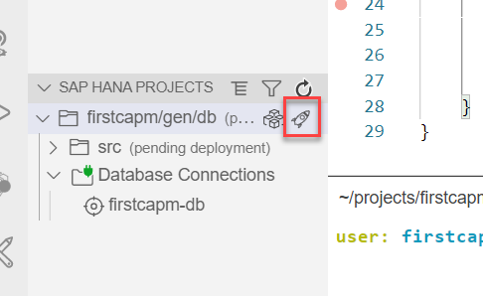
Step by Step representation to Deploy
3
2
1
4
5

Slide 15

Exercise - Association
Associations capture relationships between entities. They are like forward-declared joins added to a table definition in SQL.
Associations are specified by adding an element to a source entity that has an association type that points to a target entity and is complemented by optional information defining cardinality and which keys to use.
In this exercise we will relate the business partner table with the Address Table using the one to one Association.
Along with that we will also create the product table.
Exercise Code/Resources:
datamodel.cds

Slide 16
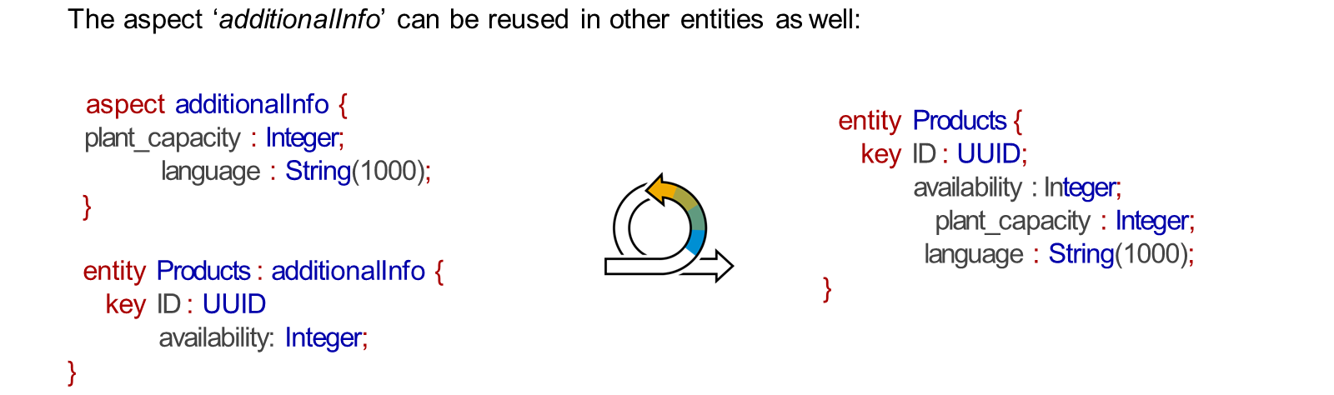
Introduction to concept of Aspects
Aspects are the reusable models that can be defined ones and then reused in other entities. Aspects allow factoring out cross-cutting or technical concerns into separate models or files, which generally facilitates keeping core domain models clean and comprehensible.
The programming model provides the option to define our own reusable objects called aspects as well as provides some common aspects that can be reused.
Reusability has several benefits:
Concise and comprehensible models
Foster interoperability between all applications
Proven best practices captured from real applications
Streamlined data models with minimal entry barriers
Optimized implementations and runtime performance

Slide 17
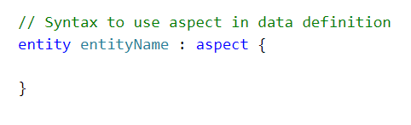
Types of Aspects
There are two types of aspects:
Standard – Provided by SAP @sap/cds/commans
Custom Aspects – User defined
@sap/cds/common defines the following aspects for use in your entity definition:
cuid: Use cuid as a convenient shortcut to add canonical, universally unique primary keys to your entity definitions
managed: Use managed to add four elements to capture created by/created at and latest changed by/changed at management information for records.
temporal: use temporal to take advantage of the built-in support that handles date-effective records and time slices.
In addition to the common aspects the programming model offers common types, These are countries, currencies, and languages.
@sap/cds/common provides predefined easy-to-use types for:
Countries
Currencies
Languages
To use aspects we have to include them by ‘using’ statement.
using { cuid } from '@sap/cds/common';

Slide 18

Exercise
In this exercise we will see the concept of reusable types and reusable aspects. We will create a new file named commons.cds, in this file we will create the reusable entities.
We will also create a new employee table in our datamodel. In this table we will use the concept of aspects.
Along with that we will also create the purchase order and purchase order item tables in the transaction context.
Exercise code/resources:
datamodel.cds
common.cds

Slide 19
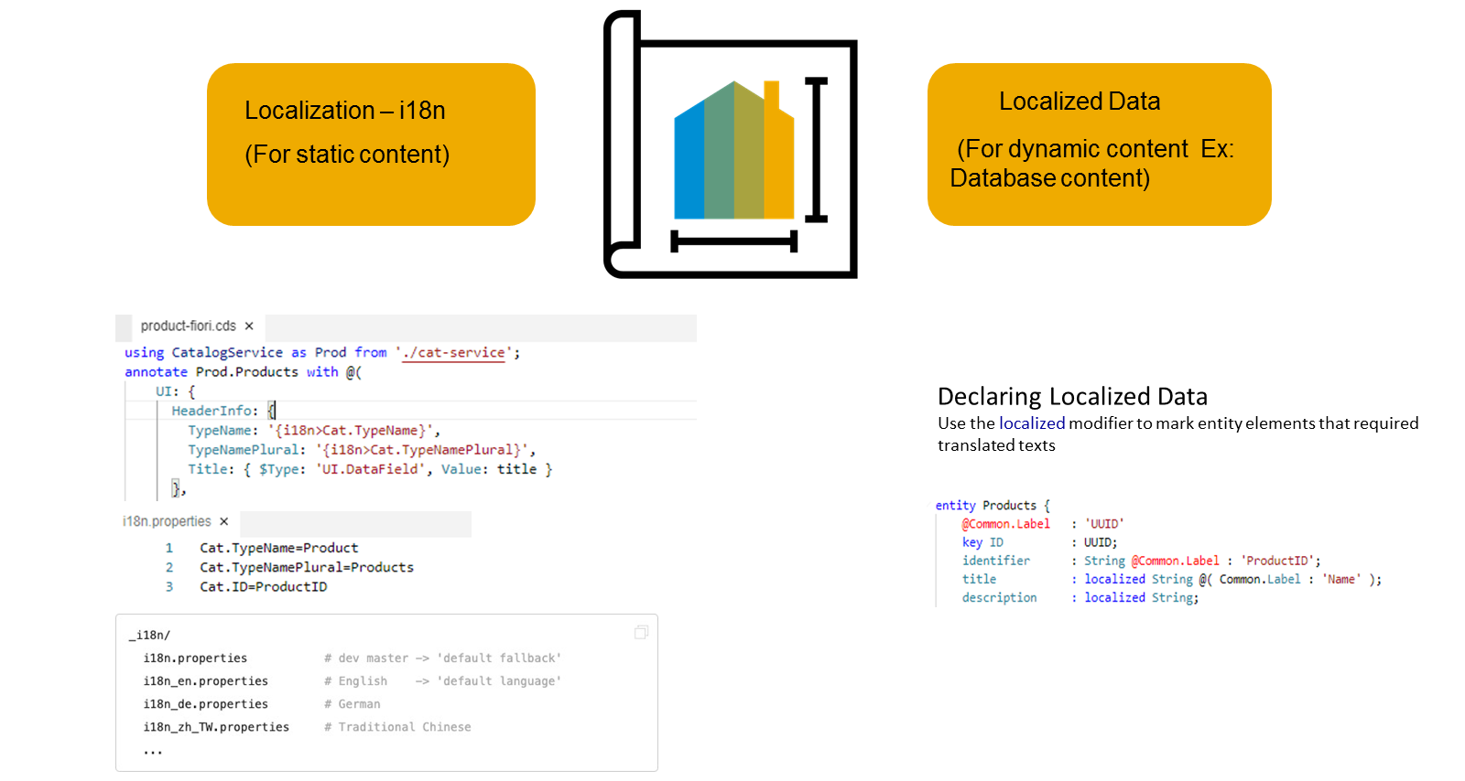
Concept of Localization
Localization refers to adapting your business application to different languages to cater to specific regional markets. This is important for anything that is visible in the UIs.
Localization is split into two categories, Localization for static content and Localization for dynamic content
Localization for dynamic content
This is achieved by marking the attributes that need to support multiple languages with a special keyword called "localized", this then creates a text table for each entity which has attributes defined as "localized"
Dynamic content that depends on the data that is stored in our persistence service.
The attributes that need to support multiple languages need to be marked with a special keyword called "localized", as we see here. In this case a text table is created for the entity.
DESCRIPTION: localized String(255);

Slide 20
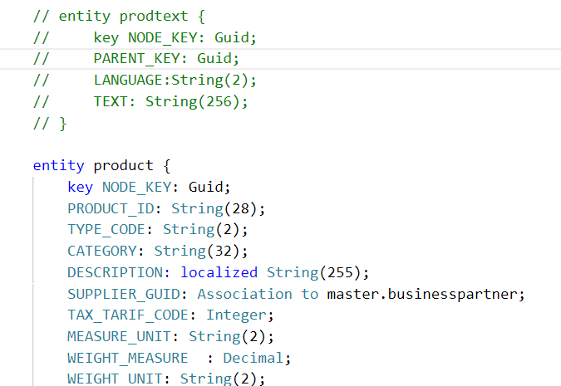
Hands-on: Dynamic Localization
In products entity remove the DESC_GUID field and add DESCRIPTION field aa localized String(255);
Exercise Code:
datamodel.cds

Slide 21
Localization for Static Content
This is achieved by externalizing all your text literals into separate text bundle files that we call the internationalization files, or in short, i18n files.
You need to maintain a separate i18n file for each language that you'd like to support.
In these i18n files, we store the actual static text as key and value pairs. Your code can then refer to the respective keys as we see here in this picture.

Slide 22

Hands-on: Localization of Data
Now we will use the annotation to give labels to the entities in our datamodel. To check the labels in the metadata we have implement a service and expose the business partner entity in the service.
Part 1: Annotating the entity in the same file
Exercise code/resource:
datamodel.cds
i18n.properties
Part 2: Annotating the properties from another file.
Exercise code/resources:
index.cds
datamodel.cds
i18n.properties
i18n_de.properties

Slide 23
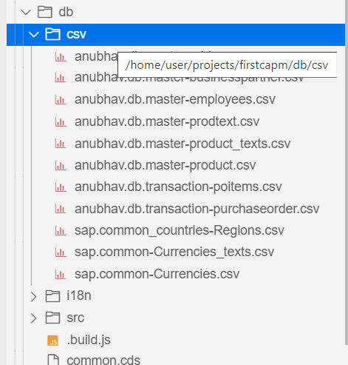
Loading initial Data in HANA Database
CSV files in your project are picked up by deployments for both SQLite and SAP HANA.
Steps to add data
The files must be located in the db/csv, db/data, or db/src/csv folders.
Each file contains data for one entity.
Filenames must follow the pattern namespace-entity.csv.
Pattern for nested entities: namespace-entity.nestedEntity.csv.
Examples: anubhav.db.master-address.csv
They must start with a header line that lists the needed element names.
When we do cds deploy --to hana
Behind the scenes it generates hdbtabledata files for the CSV files in the project. If an hdbtabledata file is already present next to the CSV files, no new file is generated.

Slide 24
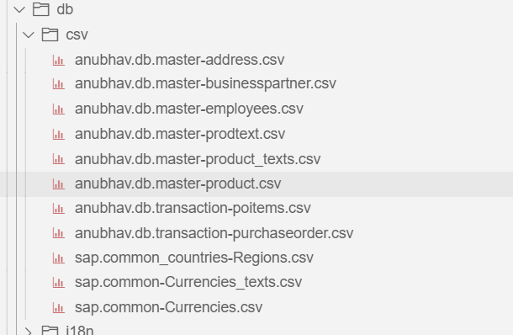
Hands-on: Loading Initial Data
In this exercise we will deploy the business partner table and address table to the HANA Cloud Database.
Exercise code/resource:
csv files

Slide 25
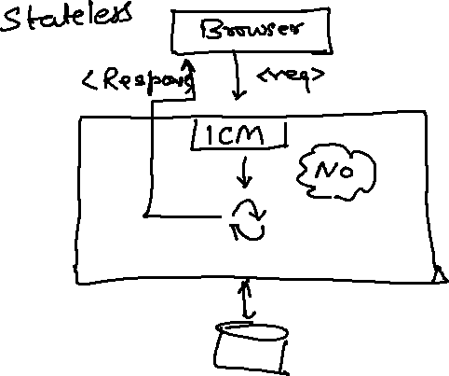
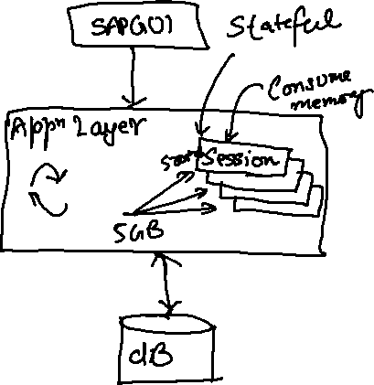
What is OData?
OData Stands for Open Data Protocol, it is an OASIS standard to communicate to server using REST based service. It was acquired by Microsoft in 2012 and adopted by many companies to build REST services to expose data over internet HTTP/HTTPs protocol.
Funda Fox
Fiori cannot talk to FM, program, CDS views, …. Fiori only and only talk to OData service which is built on top of FM, ABAP code, CDS view, etc.

Slide 26
OData Basics
This OData Protocol is mainly used to expose data over HTTP. It does not matter from consumer point, which technology the OData is built on. This way we are abstracted from the underlaying programming/database. Fiori only and only understand OData, it cannot talk to BAPI, BADI, FM, CDS View, Interface, Class.
Lets start understanding a sample OData given by Microsoft on odata.org
1. Service document – is a collection of entity sets to access the data.
An Entity set is built by an Entity Type. Entity Set is the right end point to perform CURDQ operations
Entity Type describes the structure of the data – metadata
https://services.odata.org/V3/Northwind/Northwind.svc/
2. Service metadata document – describes all the properties and entity types
Which includes key, properties, attributes (nullable, key, max length, create), NavigationProperty
Also includes the relations between entities called association (compare with Foreign key)
Usually one database table is considered as one entity.
https://services.odata.org/V3/Northwind/Northwind.svc/$metadata
https://chrome.google.com/webstore/detail/jsonview/chklaanhfefbnpoihckbnefhakgolnmc
https://chrome.google.com/webstore/detail/xml-tree/gbammbheopgpmaagmckhpjbfgdfkpadb

Slide 27
Structure of an OData URL
http(s)://hostname:port/sap/opu/odata/sap/SERVICENAME_SRV/ENTITYSET?p1=val&p2=val
Protocol
Address & Port
Service Name
End Point Access
Data
Path prefix
Query Options
Service root URL
Resource path
Service root URL: - The service root of a URL is the base URL of the service. When a GET request is made to this URL it will return a service document that defines all the resources available via that service.
Resource path: - A resource by REST definition is an object which is accessible over the HTTP by using the standard GET,POST,PUT,PATCH and DELETE methods.
Query options: - Query options are essentially standardized query string parameters that can be passed to an OData service to run queries on a requested resource. They can help perform certain operations like select, filter, count, skip, order, search and format on resources. All OData query options are prefixed by a $ sign and they are case-insensitive.

Slide 28
Client Side Query with OData
Sets the page size of results.
02
$top
Indexes into a result set. Also used by some APIs to implement paging and can be used together with $top to manually page results.
Returns the results in the specified media format.
01
03
$format
$skip
ODATA Query
06
04
Retrieves related resources.
Filters properties (columns).
$expand
$select
05
$filter
Filters results (rows).

Slide 29
GET operations
Read All the data from Products (SELECT * FROM dbtab)
https://services.odata.org/V3/Northwind/Northwind.svc/Products?$format=json
Read few properties of entity (SELECT col1, col2 FROM dbtab)
https://services.odata.org/V3/Northwind/Northwind.svc/Products?$format=json&$select=ProductID,SupplierID
Read Top Records (Pagination SELECT * UP TO ROWS n ..)
https://services.odata.org/V3/Northwind/Northwind.svc/Products?$format=json&$top=3&$skip=10
Read data by filtering (SELECT * FROM dbtab WHERE condition)
https://services.odata.org/V3/Northwind/Northwind.svc/Products?$format=json&$filter=SupplierID%20eq%203
SELECT * FROM dbtab WHERE col LIKE ‘%pattern%’
https://services.odata.org/V3/Northwind/Northwind.svc/Products?$format=json&$filter=substringof(%27Cola%27,ProductName)%20eq%20true
Reading count of the records (SELECT COUNT(*) FROM dbtab)
https://services.odata.org/V3/Northwind/Northwind.svc/Products/$count
Reading Single record by its key (SELECT SINGLE * FROM edbtab WHERE pkey = ‘key’)
https://services.odata.org/V3/Northwind/Northwind.svc/Products(11)?$format=json
Join and read data together (SELECT * FROM tab1 INNER JOIN tab2 ON cond)
https://services.odata.org/V3/Northwind/Northwind.svc/Products(11)?$format=json&$expand=Supplier,Category

Slide 30
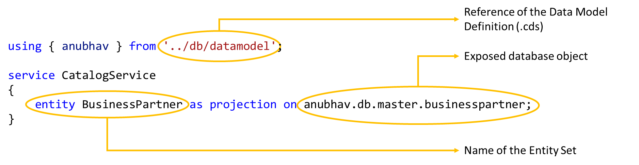
Exposing the OData Entity Set using CAPM
At design time, within the srv folder, you create an .cds file where you indicate the exposed database object, for example, table, view, calculation view, and so on, and the name of the Entity Set in the service.
On build, the application provides an OData service, exposing the object content under the given entity set name.
Syntax to Expose the OData Entity Set

Slide 31
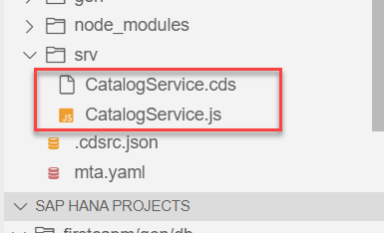
Hands-on: Exposing OData Entity
In this exercise we will expose the data form the database in the form of OData by creating a OData service.
Steps to do the exercise.
Initially we have created a CatalogService.cds and CatalogService.js file in the srv folder to check labels in the metadata.
The CatalogService.cds file is known as the service definition file.
Put the code in that file form the below link.
Run the Application using the command cds run or cds watch.
Exercise Code/Resource:
CatalogService.cds

Slide 32

End of Day 3

Slide 33

Questions

Slide 34

Anubhav Oberoy

Slide 35


We’re committed to empower you to be
Most Desirable Resource
through powerful training solutions.
We build the workforce of the future.
250+
Corporate Clients
30,000+
Learners Trained
25000+
Learners Placed
FREE WEBINARS
Sign up for free webinars with industry experts every fortnight!
Enroll Now!
Contact us today!
https://anubhavtrainings.com/

Slide 36




More from AnubhavTrainings.com

Slide 37
Title
Content

